Slide 1

Brush up on paint waste understanding the new universal paint waste rule r25-22 Illinois Pollution Control Board Members Michelle Gibson and Angela tin

Slide 2

Paint stewardship Act Senate Bill 836 (P.A. 103-372)

Slide 3

Paint MANUFACTURERS’ RESPONSBILITIES UNDER THE ACT Paint stewardship Act Senate Bill 836 (P.A. 103-372)
Manufacturers are required to develop and operate post-consumer Paint Stewardship Programs, which must:
Educate consumers reducing leftover paint
Provide opportunities for reuse of leftover paint
Ensure safe collection, transport, and end-of-life management, including reuse, recycling, and proper disposal

Slide 4
Collection Site Goals Paint stewardship Act Senate Bill 836 (P.A. 103-372)
Ensure a sufficient number and geographic distribution of collection sites
Provide access for at least 90% of Illinois residents within a 15-mile radius
Maintain at least one collection site, service, or event per 50,000 residents

Slide 5

The Amendment UNIVERSAL WASTE DESIGNATION senate bill 839 (P.A. 103-887)
Amends the Environmental Protection Act to designate paint and paint-related waste as universal waste.
Enables the program to collect, transport, and process oil-based architectural paint

Slide 6
How the statute translates to rules (R25-22)
P.A. 103-887 → Directs IEPA to propose rules for managing post-consumer paint
IPCB (R25-22) → Adopts rules to implement universal waste standards
Rule covers:
Universal waste standards (storage, labeling, transport)
How collection sites comply
Alignment with manufacturer stewardship plans

Slide 7
Issues raised on Universal waste requirements during R25-22 rulemaking
Setback requirements
Section 733.113(f)(4)(A) requires 50-foot setback from property line
Request for small quantity handlers that are drop off/collection sites to be exempt
Notification requirements
Section 733.118(g) and 733.161(c) requires facilities receiving non-universal hazardous waste to notify IEPA
Request for small quantity handlers and destination facilities to be exempt
Board decision: Exemption for small quantity No exemption provided for large or destination facilities

Slide 8
RCRA designation & universal waste
RCRA Classification: Paint may be special, universal, or hazardous waste
RCRA Permit Rule / Exemptions: Small handlers and collection sites may follow streamlined universal waste rules instead of full hazardous waste requirements
Universal Waste: Batteries, lamps, pesticides, aerosol cans, mercury-containing equipment, paint
Purpose: Ensures safe management while reducing regulatory burden for lower-risk handlers

Slide 9
Paint Stewardship Program R25-22 Universal Waste Rule
Paint Stewardship Program (PSP)
Manufacturer-funded system for collecting & recycling leftover architectural paint
Provides drop-off options for households & businesses
R25-22 Universal Waste Rule
Illinois regulation for safe management of paint and paint-related waste
Applies to anyone handling paint and paint-related waste, including architectural paint, even if it’s not collected through PSP.
Key Point:
PSP = collection system
R25-22 = how waste is handled

Slide 10

What is covered under r25-22?
Applies to anyone managing paint, paint-related waste, including architectural paint:
Residential: homeowners & DIY projects
Commercial: contractors & small businesses
Industrial: larger-scale users
Architectural paint: paints, primers, stains, and sealers, used on building, sold in containers of 5 gallons or less.
Waste is regulated:
When discarded or set aside for disposal
Purpose: Ensures leftover paint is collected, transported, and managed safely and consistently

Slide 11
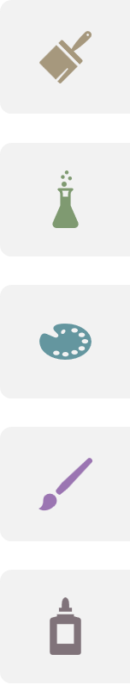
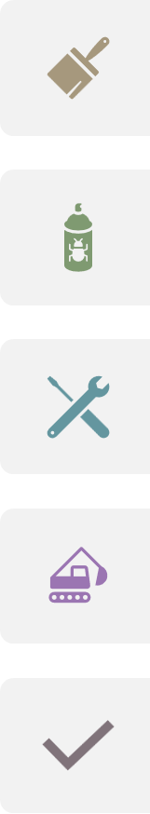
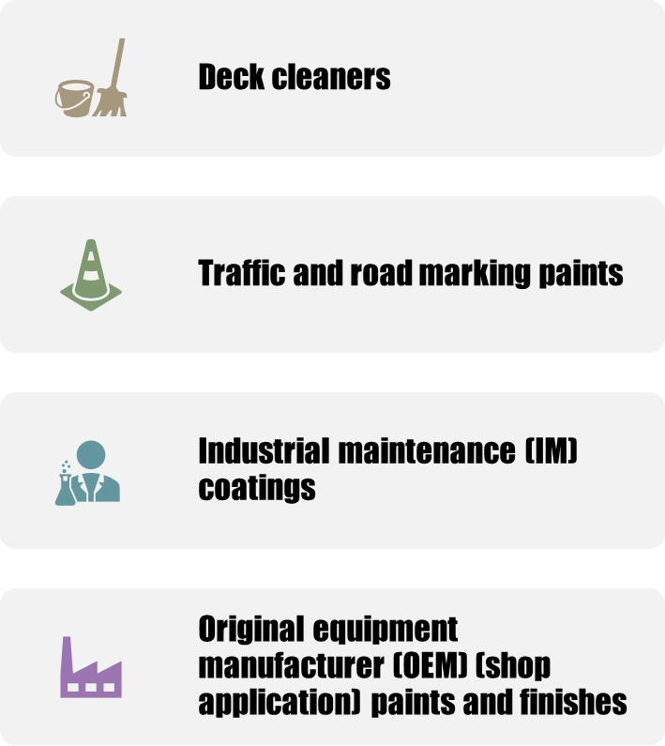
What is Not covered?
Paint mixed with solvents or materials that alter its properties
Paint that is not hazardous
Paint or related materials not regulated as waste
Examples of specific types:
Aerosols, auto/marine/OEM paints, art/craft paints
Adhesives, caulks, epoxies, paint additives, tints, resins
Wood preservatives with pesticides
Roof patch, asphalt/tar products, 2-component coatings
Deck cleaners, traffic/road marking paints, industrial maintenance coatings

Slide 12
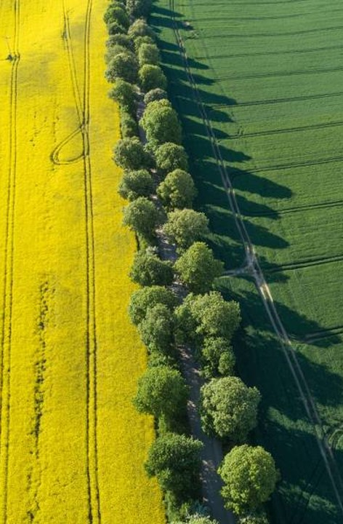
Paint waste: why is it a concern?
Volatile Organic Compounds (VOCs): Can contribute to air pollution and health risks
Heavy Metals: Older paints may contain lead, cadmium, or mercury
Flammability: Oil-based paints and solvents can pose a fire hazard
Handling & Disposal: Improper disposal can impact landfills and increase costs

Slide 13
Paintcare program
PaintCare – Illinois trade association
Contact: Jacob Saffert
(612)772-4902 / jsaffert@paint.org
Submitted on March 21, 2023
Voluntary program
Conditionally approved on June 20, 2025, for program start date: December 1, 2025

Slide 14
collection sites for leftover paint
Household hazardous waste programs
Solid waste facilities: transfer stations, recycling centers, landfills
Retail stores (paint and hardware)
Material reuse stores
Direct pickup services
PaintCare collection events

Slide 15

What do other states do?
PaintCare programs active in 10 states + Washington, D.C.
Over 2,400 drop-off sites nationwide
Nearly 78 million gallons collected cumulatively
12,266 large-volume pickups & 381 drop-off events
New programs launching in Illinois and Maryland

Slide 16
Illinois volumes & 4–Year Projections
New Paint Sales: 22M gallons/year
Projected Collection: 933,000–1.1M gallons/year
Recovery Percentage: 80% latex / 20% oil based
Recovery Rates: Nationwide: 3%–12%; Illinois projected: 4.5%–5.6% by Year 4
Trend: Recovery rates increase each year, then stabilize

Slide 17
References
Illinois Paint Stewardship Program Plan, PaintCare Illinois LLC, March 21, 2025
35 Ill. Adm. Code 733: Illinois Pollution Control Board’s Standards for Universal Waste Management

Slide 18
Stakeholders and outreach
Program fees and cost concerns
Retailers, governments, and community groups engaged
Outreach tools: brochures, website, site locator, hotline
Ongoing evaluation of outreach effectiveness

Slide 19
Environmental benefits
Air: lower VOC emissions, safer handling
Water: reduced contamination risks from improper disposal
Land: less landfill waste, safer reuse/recycling
Positive economic impact
Reuse: latex reprocessing, oil-based bulking
Energy recovery: fuel blending, landfill cover use
Efficient transportation operations

Slide 20

Making It Official: The Rulemaking Process

Slide 21

rulemaking process overview
How Illinois adopts, amends, or repeals environmental rules
Guided by state law and administrative procedures
Can apply statewide or to a specific site

Slide 22
Who can propose rules?
The Board: in response to state or federal requirements
The IEPA: may be directed by legislation
Others: Individuals, associations, citizen groups, units of local government, and businesses

Slide 23
What is the process for a general rulemaking?
Proposal filed
Board accepts proposal and holds hearings
First notice → public comment period
Second notice → legislative review
Final adoption
Effective date

Slide 24
Hearings
At least two hearings for statewide rules
Must be held in different parts of Illinois
Allows public and stakeholder input

Slide 25
First notice
Board may revise proposal before publishing
Published in the Illinois Register
Opens a 45-day minimum public comment period

Slide 26
second notice
Board may make further revisions
Sent to the Joint Committee on Administrative Rules (JCAR)
No major changes allowed at this stage

Slide 27
Possible actions by jcar
No Objection
→ Rule moves forward
Recommendations
→ Board must respond within 90 days
Objections
→ Board can revise, withdraw, or adopt over objection
Filing prohibition
→ Board cannot file until modifications are made

Slide 28
Final adoption
Board issues order and files with Secretary of State
Rule becomes effective once accepted
Published in the Illinois Register

Slide 29

Special rulemakings with shortened timelines
Identical-in-Substance – must match federal rules exactly
Federally Required – required by federal law, state can adjust details
Clean Air Act Fast-Track – shortened timeline set by law
Statutory Deadlines – state law sets adoption date or number of days (e.g., Community Right-to-Know, Clean Construction/Demolition Debris)

Slide 30

Public participation
Submit written comments or testimony
Speak at a hearing
Sign up for notices or the Board’s service list

Slide 31
Participation in fast-track rules
Timelines are accelerated
First hearing occurs shortly after filing (timeline varies by rule)
Additional hearings may be requested, but are limited in scope

Slide 32
Ex parte communications
Board members cannot be contacted privately to influence decisions
Any off-the-record communication must be entered into the public record
Ensures transparency, fairness, and impartial rulemaking

Slide 33

Board information
Submit documents to the Clerk’s Office:
Electronic filing available through COOL: www.ipcb.state.il.us
Paper filing:
Illinois Pollution Control Board
Clerk’s Office – Attn: Don Brown
60 E. Van Buren, Suite 630
Chicago, IL 60605

Slide 34
Thank you
Board Member Michelle Gibson
Board Member Angela Tin
https://pcb.illinois.gov/
R25-22 Docket
Marie.Tipsord@illinois.gov
General Counsel

